Slide 1
Topics to be Covered
Basic Probability Rules (Reminded)
The Law of Total Probability
Bayes Theorem

Slide 2


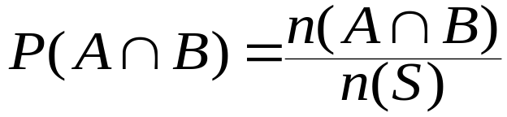

Basic Rules for Probability - Reminder
Range of Values
Complements - Probability of not A
Intersection - Probability of both A and B
Mutually exclusive events (A and C) :

Slide 3
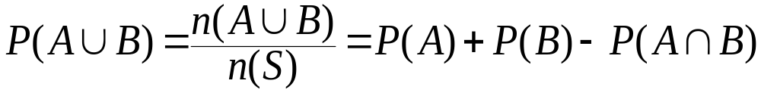
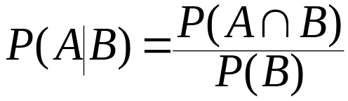
Basic Rules for Probability - Reminder
Union - Probability of A or B or both
  Mutually exclusive events:
Conditional Probability - Probability of A given B
The probability that A occurs given that B has already occurred. We also use if and suppose.

Slide 4
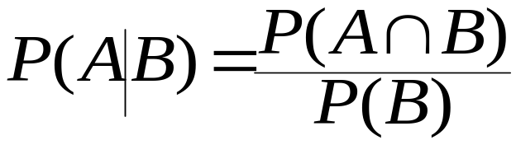
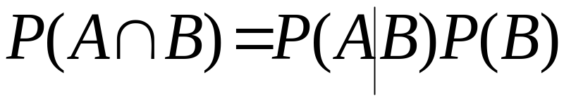
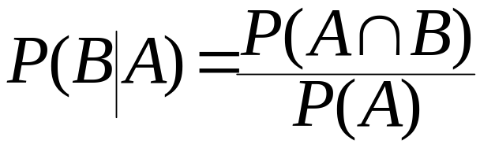
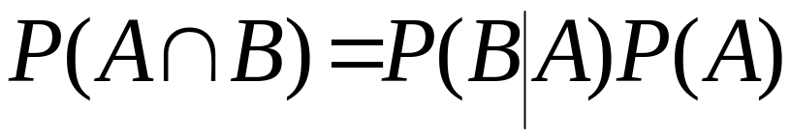
Basic Rules for Probability - Reminder
Rules of conditional probability (extended):
a)
so
b)
so
7c)
7d)

Slide 5
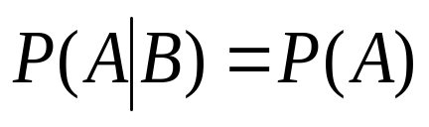
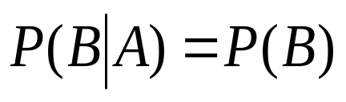
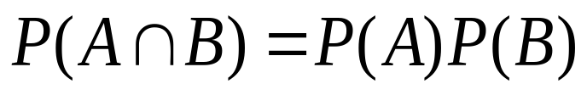
Independence of Events
8. Conditions for the statistical independence of events A and B:
a)
b)
c)
8a and 8b imply 8c if we use 7c and 7d
Instead of P(A|B) use P(A)
Instead of P(B|A) use P(B)

Slide 6
Procedure to Follow
Define the events of interest
Write down the information given in terms of your definitions.
Write down the question given in terms of your definitions.
Use an appropriate rule to answer your question (s).

Slide 7
Contingency Table (Example)
As part of a drive to modernize the economy,
the government of an Eastern European
country is pushing for starting 100 new projects
in computer development and
telecommunications. Two U.S. giants, IBM and
AT&T, have signed contracts for these projects:
40 projects for IBM and 60 projects for AT&T.
Of the IBM projects, 30 are in the computer
area and 10 are in telecommunications. Of the
AT&T projects, 20 are in the computer area and
40 are in telecommunications.
What is the probability that a project is
undertaken by IBM given it is a
telecommunications project?

Slide 8
Contingency Table (Example)
Define
C = the event the project is in computer developmnt
T = the event the project is in telecommunications
I = the event the project is undertaken by IBM, and
A = the event the project is undertaken by AT&T,
Given:
P(I) = 0.40; P(A) = 0.60; P(I∩C) = 0.30; P(I∩T) = 0.10
P(A∩C) = 0.20; P(A∩T) = 0.40
P(C|I) = 0.75; P(T|I) = 0.25 (Can you prove these?)
P(C|A) = 1/3 ; P(T|A) = 2/3 (Can you prove these?)
Question: P(I|T) =?

Slide 9
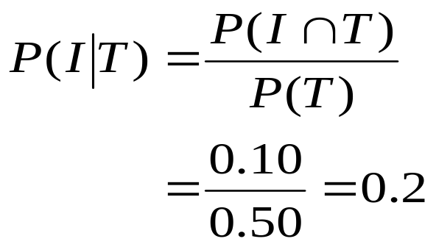
Contingency Table (Example)
Counts
AT& T
IBM
Total
Tele-
communication
Probability that a project is undertaken by IBM given it is a telecommunications project:
40
10
50
Computers
20
30
50
Total
60
40
100
Probabilities
AT& T
IBM
Total
Tele-
communication
.40
.10
.50
Computers
.20
.30
.50
Total
.60
.40
1.00

Slide 10
Independence (Example)
The probability that a consumer will be exposed to a TV ad for a certain product is 0.04. The probability that the consumer will be exposed to a billboard ad for the same product is 0.06. The two events, being exposed to the TV commercial and being exposed to the billboard ad, are assumed to be independent.
  What is the probability the consumer will be exposed to both ads?
  What is the probability that he or she will be exposed to at least one of the two ads?

Slide 11
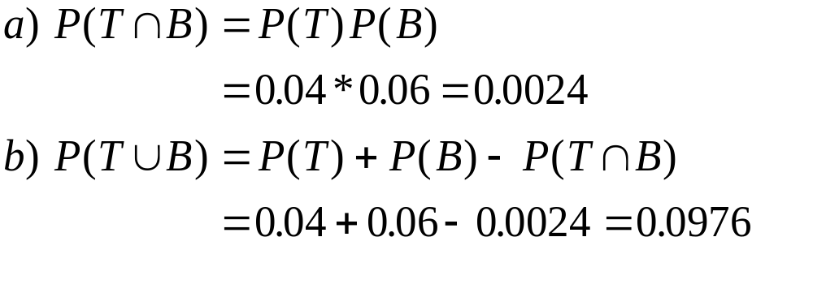
Independence of Events (Example)
Define T as the event the ad is seen on Television
and B as the event the ad is seen on Billboard.
These are assumed to be independent.
You have to identify intersection in a.
You have to identify union in b.

Slide 12
Product Rules for Independent Events
The probability of the intersection of several independent events is the product of their separate individual probabilities:
The probability of the union of several independent events is 1 minus the product of probabilities of their complements:

Slide 13
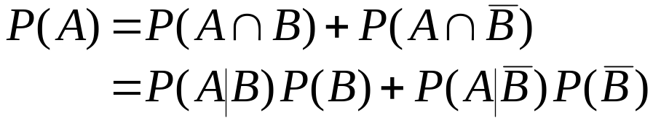
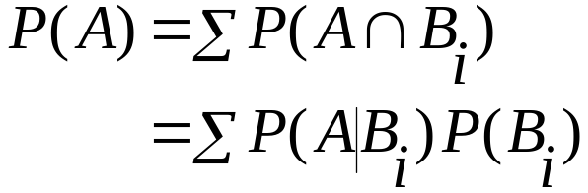
The Law of Total Probability
When one event depends on more than one other:
In terms of conditional probabilities:
More generally (where B_{i} make up a partition):

Slide 14
The Law of Total Probability
If the occurrence of one event, A, depends on the occurrence of more than one other event B_{i}, then the law of total probability calculates the probability of A using the information from all the other events.

Slide 15
The Law of Total Probability: Example 1
In a takeover bid for a certain firm, management of the raiding firm believes there is a 0.75 chance of success (successful takeover) if a member of the raided firm resigns, and there is a 0.30 chance of success if the member does not resign. They also believe that there is a 0.70 chance of the member resigning. What is the probability of a successful takeover?
We can see that in this example, success, which is taking over the firm depends on two events – the board member resigning and the board member not resigning (complements)

Slide 16




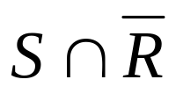
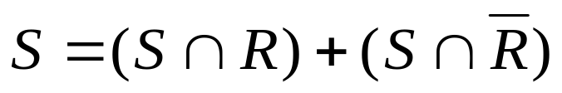

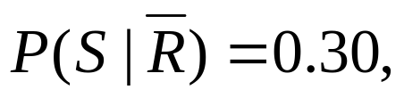

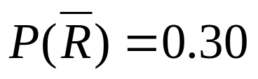
The Law of Total Probability: Example 1
Let S = the event of a successful takeover
R = the event of the member of the board resigns
Then
………………. (1)
But we know from the given information that:

Slide 17
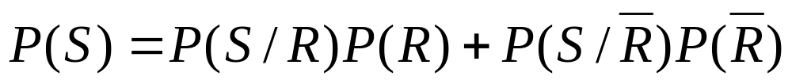
The Law of Total Probability: Example 1
But we know from the given information that:
By the Law of Total Probability
Therefore

Slide 18
The Law of Total Probability: Example 2
An analyst believes the stock market (index) has a 0.75 probability of going up in the next year if the economy should do well, and a 30% probability of going up in the next year if the economy should not do well in the year. The analyst further believes the economy has a 0.80 probability that the economy will do well in the coming year. Using the analyst’s assessments, what is the probability that the stock market will go up in the next year?

Slide 19
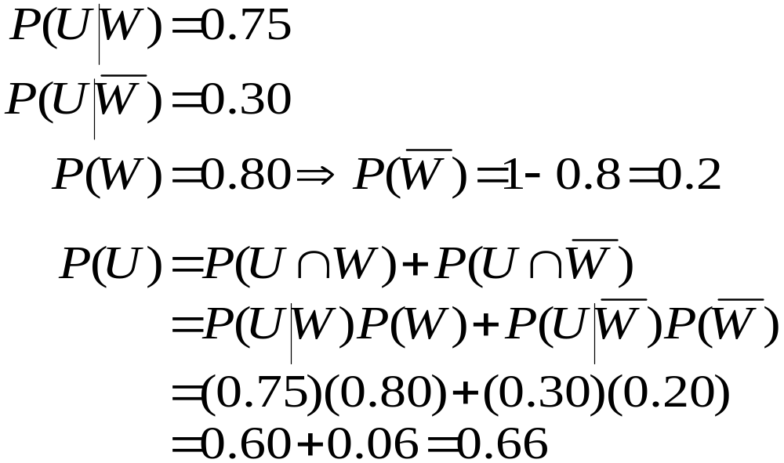
The Law of Total Probability:
Example 2
Event U: Stock market will go up in the next year
Event W: Economy will do well in the next year

Slide 20
Bayes’ Theorem
Bayes’ theorem
enables the finding of the probability of B given A, knowing just a little more than the probability of A given B
based on the definition of conditional probability and the law of total probability.
allows us to update or revise the probability of an event, after some other event has occurred. It does so by reversing the order of conditionality. That is, if we need P(B|A) we would have the information on P(A|B).

Slide 21
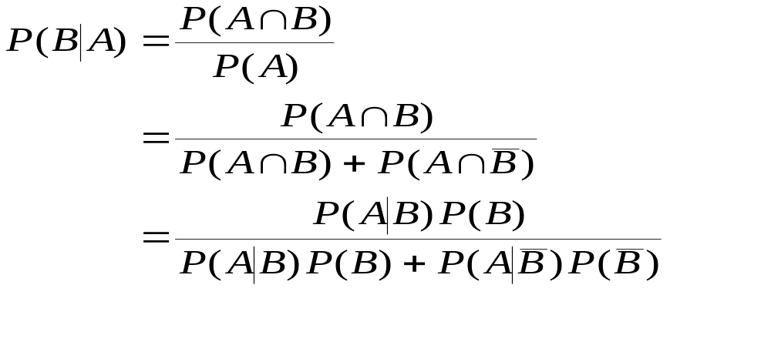
Bayes’ Theorem
The new probability of B, P(B|A) is called the posterior probability, posterior to A occurring. We would have information on the prior probability of B, P(B).
Revising probabilities after some other event has occurred:
Applying the law of total
probability to the denominator
Applying the definition of conditional probability throughout

Slide 22
Bayes’ Theorem
Example
A medical test for a rare disease affecting 0.1% of the population is imperfect. :
  When administered to an ill person, the test will indicate so with probability 0.92. (The event the test result is negative if the person is ill is a false negative.)
  When administered to a person who is not ill, the test will erroneously give a positive result (false positive) with probability 0.04
If a person is randomly tested from the entire population and the result is positive, what is the posterior probability (posterior to the test result) that the person is ill?

Slide 23
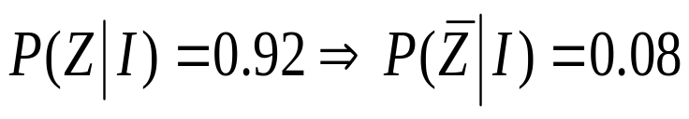
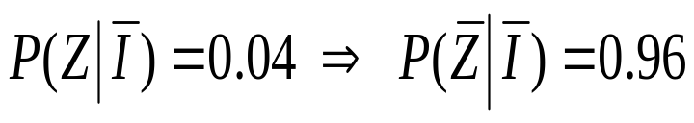
Bayes’ Theorem
Example
Let Z = the event the test is positive and
I = the event the person is ill
  P(I) = 0.001;
  P(Z|I) = 0.92
  P(Z|Ī) = 0.04
  Question P(I|Z) =?
P(I|Z) = P(Z∩I)/P(Z)

Slide 24
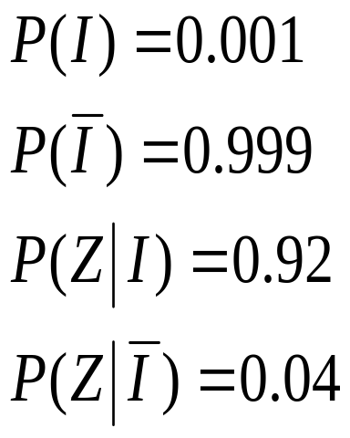
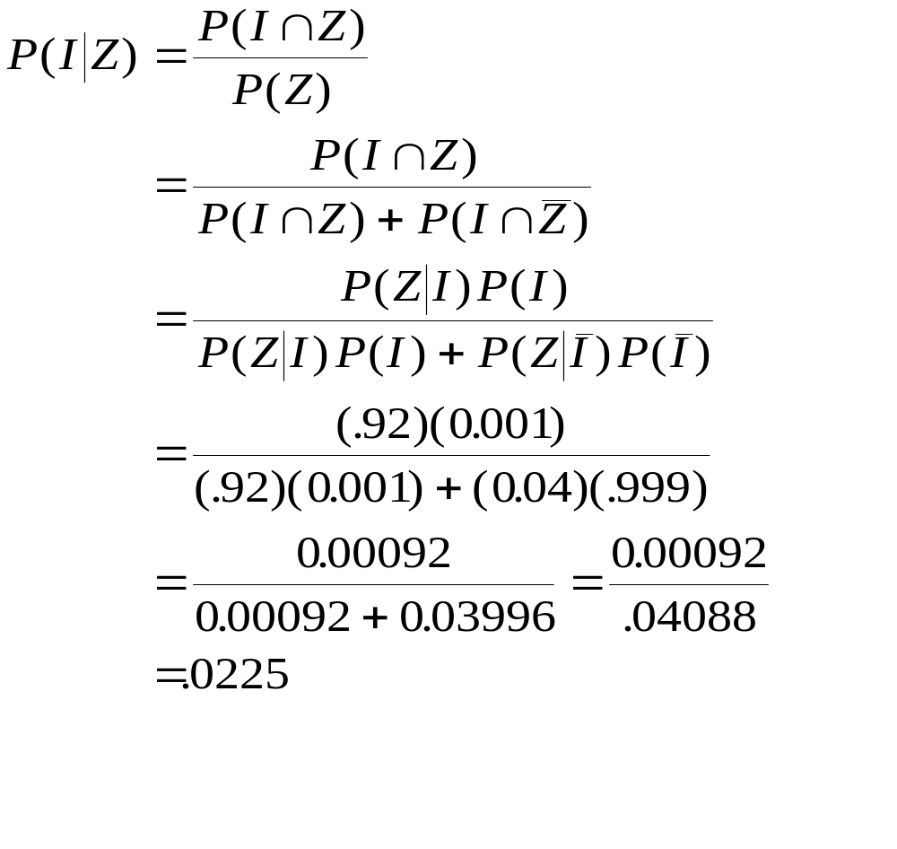
Bayes’ Theorem
Example

Slide 25









Example (Tree Diagram)
Prior
Probabilities
Conditional
Probabilities
Joint
Probabilities

Slide 26
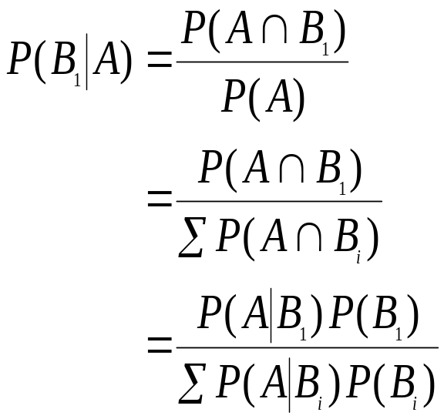
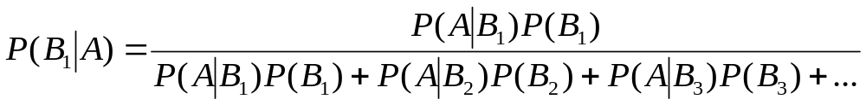
Bayes’ Theorem Generalized
Given a partition of events B₁,B₂ ,...,B_{n}:
Applying the law of total
probability to the denominator
Applying the definition of
conditional probability throughout

Slide 27
Topics Covered
Basic Probability Rules (Reminded)
The Law of Total Probability
Bayes Theorem

